Slide 1

#LifeKoKaroLift
Java
Program
<number>
08/01/2021

Slide 2



Course : Java Program
Lecture On : Arrays & Linked Lists
Instructor : Rahul Kumar
08/01/2021
<number>

Slide 3
Today’s Agenda
Arrays
ArrayList and LinkedList
Basic operations in ArrayList and LinkedList
Lists and polymorphism
08/01/2021
Java Program
<number>
Notes:
39

Slide 4
Arrays
Java Arrays
Normally, an array is a collection of similar type of elements which has contiguous memory location.
Java array is an object which contains elements of a similar data type. Additionally, The elements of an array are stored in a contiguous memory location. It is a data structure where we store similar elements. We can store only a fixed set of elements in a Java array.
Array in Java is index-based, the first element of the array is stored at the 0th index, 2nd element is stored on 1st index and so on.
In Java, array is an object of a dynamically generated class. Java array inherits the Object class, and implements the Serializable as well as Cloneable interfaces. We can store primitive values or objects in an array in Java. Like C/C++, we can also create single dimentional or multidimentional arrays in Java.
Moreover, Java provides the feature of anonymous arrays
08/01/2021
<number>

Slide 5
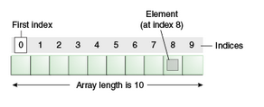
Arrays
Advantages
Code Optimization: It makes the code optimized, we can retrieve or sort the data efficiently.
Random access: We can get any data located at an index position.
Disadvantages
Size Limit: We can store only the fixed size of elements in the array. It doesn't grow its size at runtime. To solve this problem, collection framework is used in Java which grows automatically.
08/01/2021
4

Slide 6

Arrays
Types of Array in java
There are two types of array.
Single Dimensional Array
Multidimensional Array
Single Dimensional Array in Java
Syntax to Declare an Array in Java
Instantiation of an Array in Java
08/01/2021
5

Slide 7
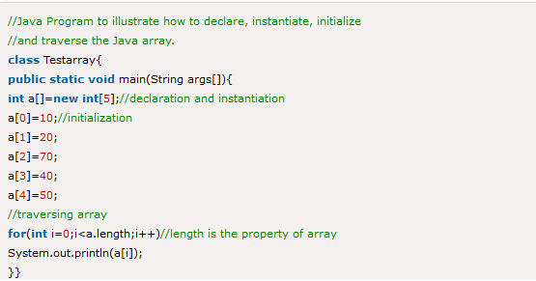
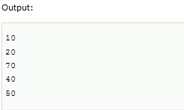
Arrays
Example of Java Array
Let's see the simple example of java array, where we are going to declare, instantiate, initialize and traverse an array.
08/01/2021
6

Slide 8
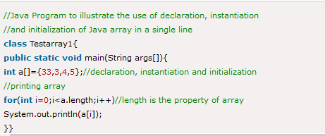
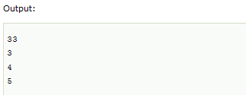
Arrays
Declaration, Instantiation and Initialization of Java Array
We can declare, instantiate and initialize the java array together by:
Let's see the simple example to print this array.
08/01/2021
7

Slide 9

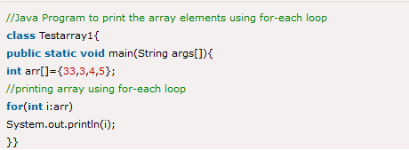
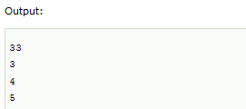
Arrays
For-each Loop for Java Array
We can also print the Java array using for-each loop. The Java for-each loop prints the array elements one by one. It holds an array element in a variable, then executes the body of the loop.
The syntax of the for-each loop is given below:
Let us see the example of print the elements of Java array using the for-each loop.
08/01/2021
8

Slide 10
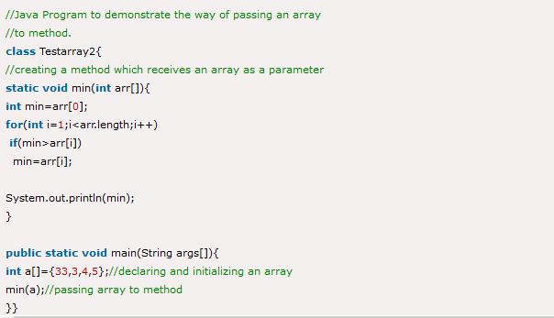

Arrays
Passing Array to a Method in Java
We can pass the java array to method so that we can reuse the same logic on any array.
Let's see the simple example to get the minimum number of an array using a method.
08/01/2021
9

Slide 11
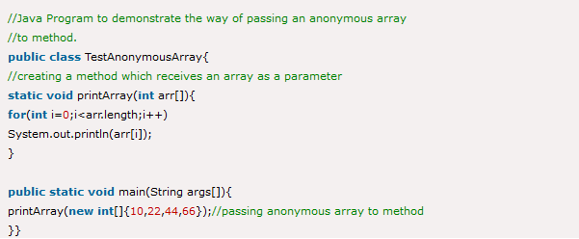
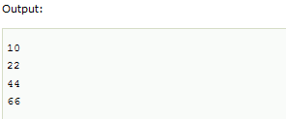
Arrays
Anonymous Array in Java
Java supports the feature of an anonymous array, so you don't need to declare the array while passing an array to the method.
08/01/2021
10

Slide 12
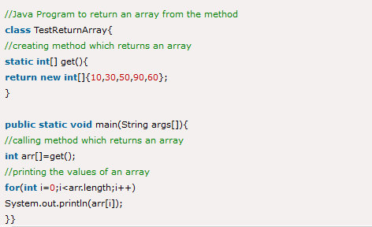
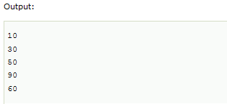
Arrays
Returning Array from the Method
We can also return an array from the method in Java.
08/01/2021
11

Slide 13
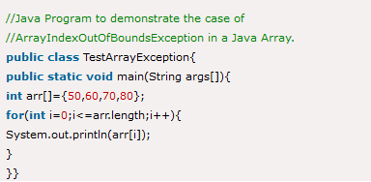
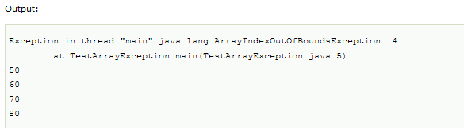
Arrays
ArrayIndexOutOfBoundsException
The Java Virtual Machine (JVM) throws an ArrayIndexOutOfBoundsException if length of the array in negative, equal to the array size or greater than the array size while traversing the array.
08/01/2021
12

Slide 14

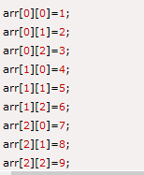
Arrays
Multidimensional Array in Java
In such case, data is stored in row and column based index (also known as matrix form).
Syntax to Declare Multidimensional Array in Java
Example to instantiate Multidimensional Array in Java
Example to initialize Multidimensional Array in Java
08/01/2021
13

Slide 15
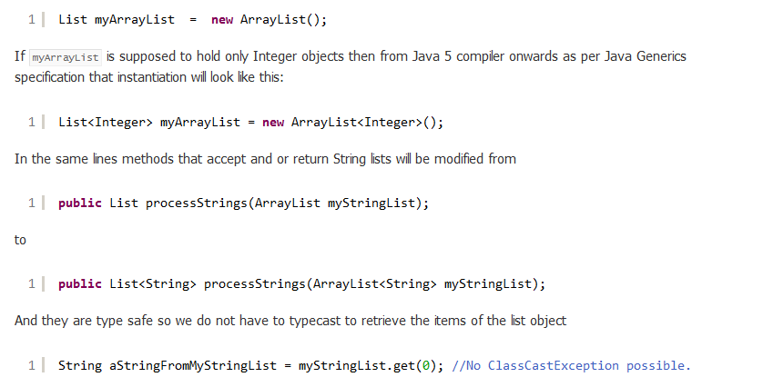
Polymorphism and Arrays
Since the early days as Java programmer we all know how to instantiate and use Collection objects. A List interface instantiated as a concrete class will look like the below.
08/01/2021
14

Slide 16

Polymorphism and Arrays
The above will not compile if a String From MyStringList is declared anything other than String.
Till here we should be satisfied about how Object oriented Java worked, but the next item may surprise many.
When we are using
List<Integer> myArrayList = new ArrayList<Integer>();
meant that we should be using “Integer” only in the ArrayList and NOTHING ELSE. Wait a minute, aren’t generics a part of OOP, means can’t we apply polymorphism in these objects? The answer is NO. Let’s see why.
We have already seen Polymorphism applies to the base type of collections and that is why List<Integer> myArrayList can be instantiated as new ArrayList<Integer>();
But what about this:
08/01/2021
15

Slide 17

Polymorphism and Arrays
Using the above the following instantiation not work will and end up in Compilation Error.
The simple rule is the type of the variable declaration must match the type you pass to the actual object type. If we declare List<Parent> myList then whatever I assign to myList MUST be exactly of type <Parent> only and not a subtype of Parent class not a supertype of Parent class.
That means the correct code is:
But the above contradicts with traditional java programmers who are accustomed to use the below which is legal.
08/01/2021
16

Slide 18
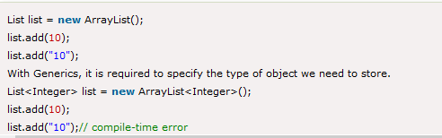
Generics in Java
Generics in Java
The Java Generics programming is introduced in J2SE 5 to deal with type-safe objects. It makes the code stable by detecting the bugs at compile time.
Before generics, we can store any type of objects in the collection, i.e., non-generic. Now generics force the java programmer to store a specific type of objects.
Advantage of Java Generics
There are mainly 3 advantages of generics. They are as follows:
1) Type-safety: We can hold only a single type of objects in generics. It doesn?t allow to store other objects.
Without Generics, we can store any type of objects.
08/01/2021
17

Slide 19
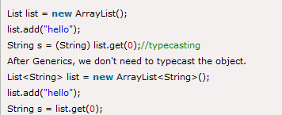

Generics in Java
2) Type casting is not required: There is no need to typecast the object.
Before Generics, we need to type cast.
3) Compile-Time Checking: It is checked at compile time so problem will not occur at runtime. The good programming strategy says it is far better to handle the problem at compile time than runtime.
08/01/2021
18

Slide 20


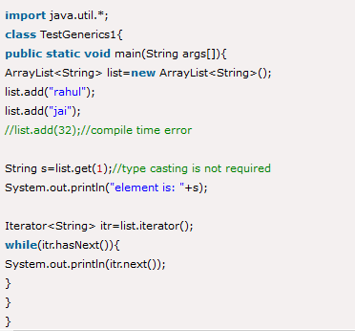
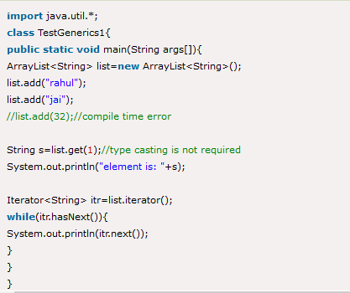
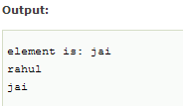
Generics in Java
Syntax to use generic collection
Example to use Generics in java
Full Example of Generics in Java
Here, we are using the ArrayList class, but you can use any collection class such as ArrayList, LinkedList, HashSet, TreeSet, HashMap, Comparator etc.
08/01/2021
19

Slide 21
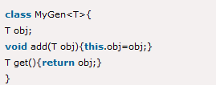
Generics in Java
Generic class
A class that can refer to any type is known as a generic class. Here, we are using the T type parameter to create the generic class of specific type.
Let's see a simple example to create and use the generic class.
Creating a generic class:
The T type indicates that it can refer to any type (like String, Integer, and Employee). The type you specify for the class will be used to store and retrieve the data.
08/01/2021
20

Slide 22
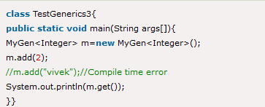

Generics in Java
Using generic class:
Let's see the code to use the generic class.
Type Parameters
The type parameters naming conventions are important to learn generics thoroughly. The common type parameters are as follows:
T - Type
E - Element
K - Key
N - Number
V - Value
08/01/2021
21

Slide 23
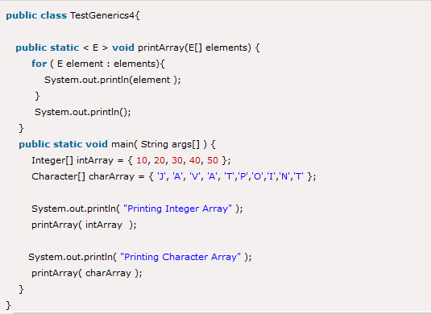
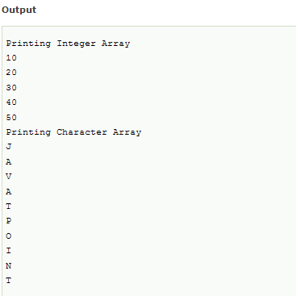
Generics in Java
Generic Method
Like the generic class, we can create a generic method that can accept any type of arguments. Here, the scope of arguments is limited to the method where it is declared. It allows static as well as non-static methods.
Let's see a simple example of java generic method to print array elements. We are using here E to denote the element.
08/01/2021
22

Slide 24
ArrayList
Java ArrayList class uses a dynamic array for storing the elements. It is like an array, but there is no size limit. We can add or remove elements anytime. So, it is much more flexible than the traditional array. It is found in the java.util package. It is like the Vector in C++.
The ArrayList in Java can have the duplicate elements also. It implements the List interface so we can use all the methods of List interface here. The ArrayList maintains the insertion order internally.
It inherits the AbstractList class and implements List interface.
The important points about Java ArrayList class are:
Java ArrayList class can contain duplicate elements.
Java ArrayList class maintains insertion order.
Java ArrayList class is non synchronized.
Java ArrayList allows random access because array works at the index basis.
In ArrayList, manipulation is little bit slower than the LinkedList in Java because a lot of shifting needs to occur if any element is removed from the array list.
08/01/2021
23

Slide 25
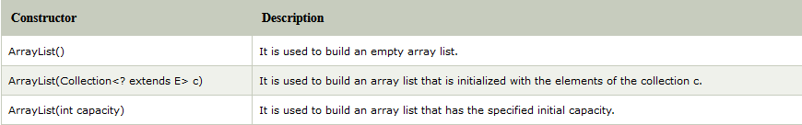
ArrayList
ArrayList class declaration
Let's see the declaration for java.util.ArrayList class.
Constructors of ArrayList
08/01/2021
24

Slide 26
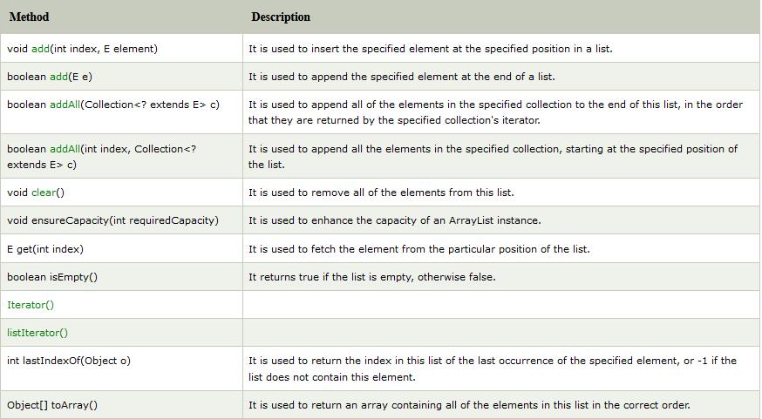
ArrayList
Methods of ArrayList
08/01/2021
25

Slide 27
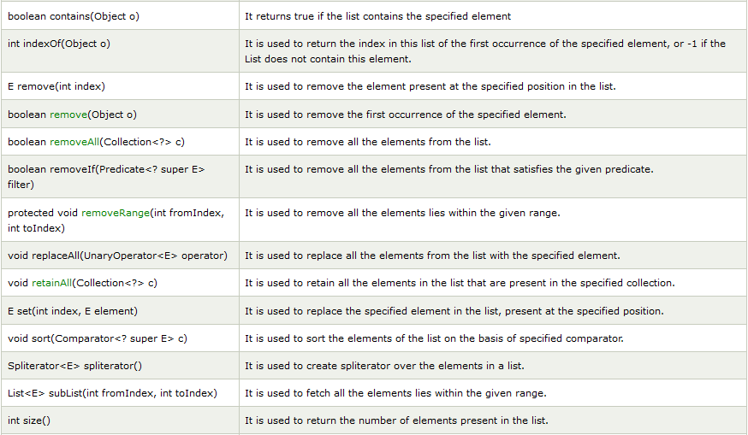
ArrayList
Methods of ArrayList
08/01/2021
26

Slide 28
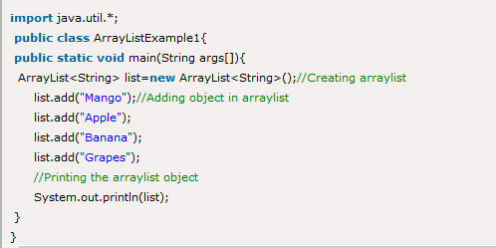

ArrayList
Java ArrayList Example
08/01/2021
27

Slide 29

LinkedList
Java LinkedList class
Java LinkedList class uses a doubly linked list to store the elements. It provides a linked-list data structure. It inherits the AbstractList class and implements List and Deque interfaces.
The important points about Java LinkedList are:
Java LinkedList class can contain duplicate elements.
Java LinkedList class maintains insertion order.
Java LinkedList class is non synchronized.
In Java LinkedList class, manipulation is fast because no shifting needs to occur.
Java LinkedList class can be used as a list, stack or queue
Doubly Linked List
In the case of a doubly linked list, we can add or remove elements from both sides.
08/01/2021
28

Slide 30
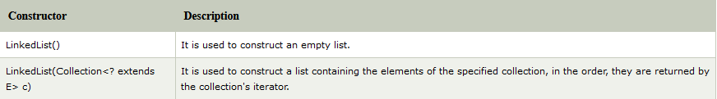
LinkedList
LinkedList class declaration
Let's see the declaration for java.util.LinkedList class.
Constructors of Java LinkedList
08/01/2021
29

Slide 31
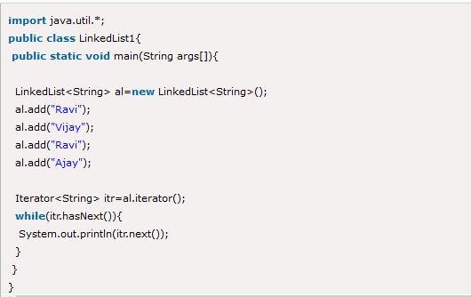

LinkedList
Java LinkedList Example
08/01/2021
30

Slide 32
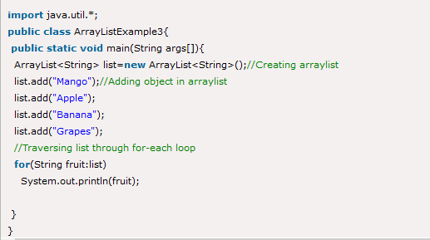

Basic operations in ArrayList
Iterating ArrayList using For-each loop
Let's see an example to traverse the ArrayList elements using the for-each loop
08/01/2021
31

Slide 33
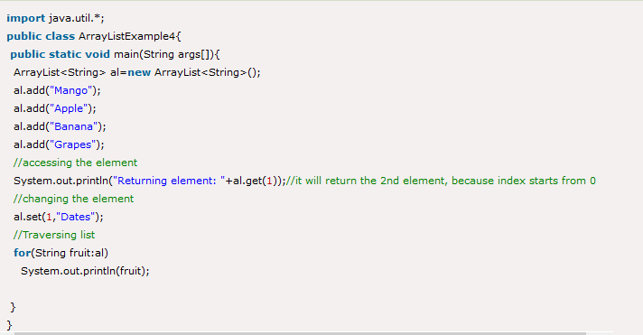
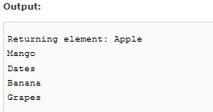
Basic operations in ArrayList
Get and Set ArrayList
The get() method returns the element at the specified index, whereas the set() method changes the element.
08/01/2021
32

Slide 34
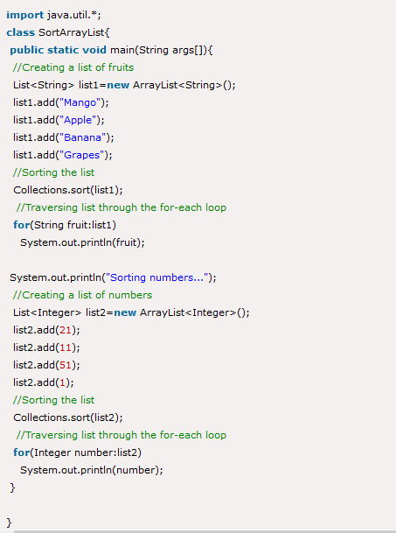
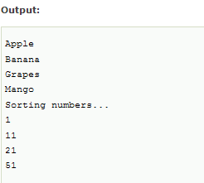
Basic operations in ArrayList
How to Sort ArrayList
The java.util package provides a utility class Collections which has the static method sort(). Using the Collections.sort() method, we can easily sort the ArrayList.
08/01/2021
33

Slide 35
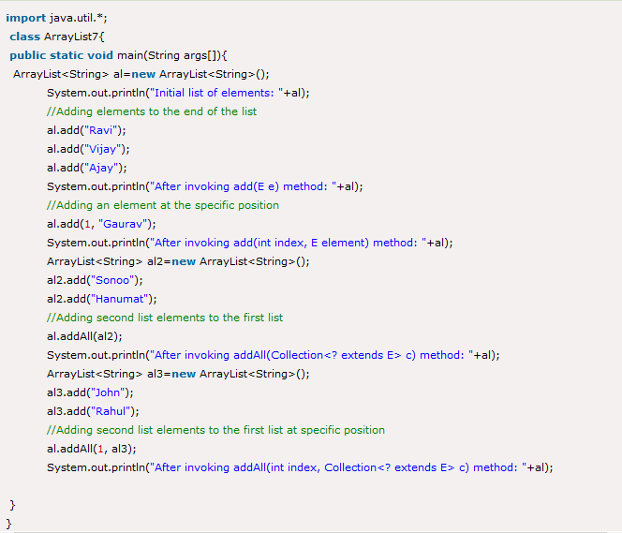
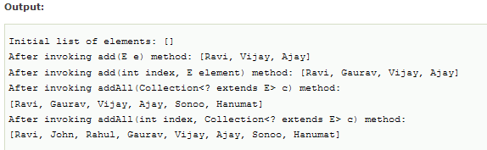
Basic operations in ArrayList
Java ArrayList example to add elements
Here, we see different ways to add an element.
08/01/2021
34

Slide 36
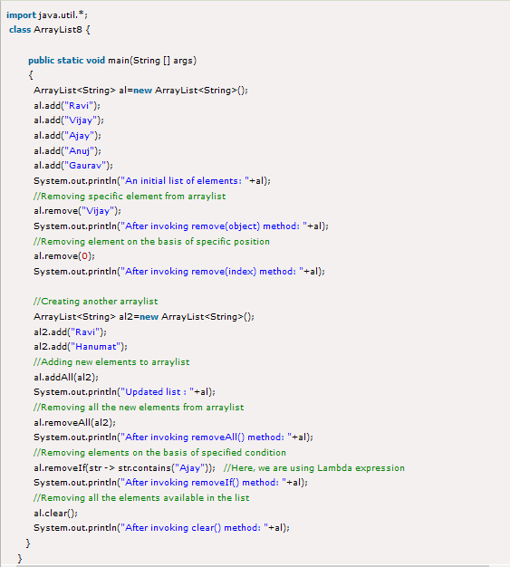
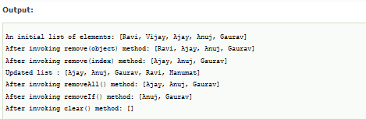
Basic operations in ArrayList
Java ArrayList example to remove elements
Here, we see different ways to remove an element.
08/01/2021
35

Slide 37
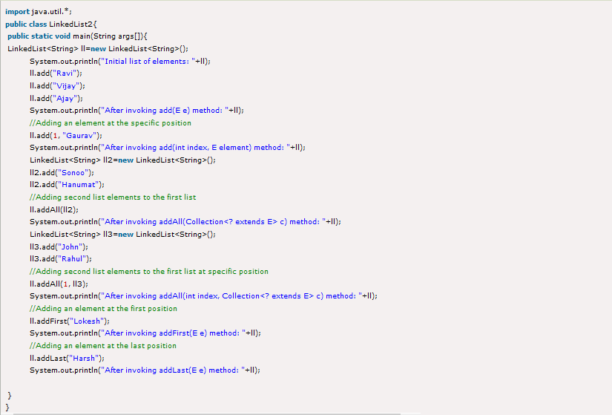
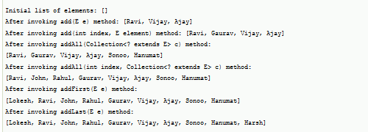
Basic operations in LinkedList
Java LinkedList example to add elements
Here, we see different ways to add elements
08/01/2021
36

Slide 38
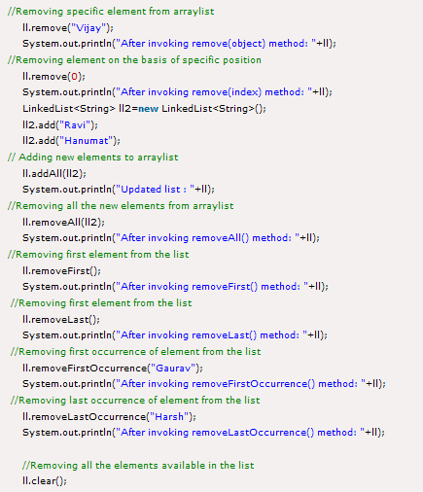
Basic operations in LinkedList
Java LinkedList example to remove elements
Here, we see different ways to remove an element.
08/01/2021
37

Slide 39
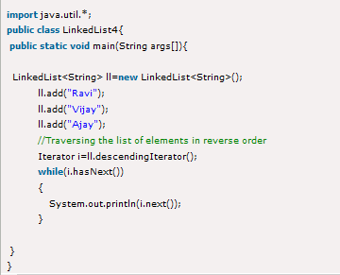

Basic operations in LinkedList
Java LinkedList Example to reverse a list of elements
08/01/2021
38

Slide 40
#LifeKoKaroLift
Thank You!
39
08/01/2021

